Slide 1

Week 8: From RAG Workflows to Agents

Slide 2

RAG Ends Hallucination Nightmares
28.6%
Support Time Reduction at LinkedIn
LLMs freeze knowledge at training cutoff and invent facts. RAG gives AI perfect, real-time memory of your company’s knowledge.
$40B
Market Size by 2035
The Shift: 80% of enterprises now choose RAG over fine-tuning.
Accuracy
Speed

Slide 3


RAG Is a Library Card for AI
Upgrade your genius student with an always-available research librarian.
LLM Alone
LLM + RAG
A brilliant student who studied only until 2023, with no access to new information.
The same student given a real-time library card to access infinite, current knowledge.
1. Retrieve
2. Embed
3. Generate

Slide 4
RAG Workflow in One Glance
From Query to Cited Answer: A journey of precision and speed.
1
2
3
4
5
6
Vector DB Search
Retrieved Chunks
Answer
Query
Embedding
LLM Prompt
User Question
Convert to Vector
Context + Query
Grounded Response
Find Matches
Relevant Context
Total Retrieval Latency: < 500ms

Slide 5

Embeddings Cluster Meaning
Turning text into numerical vectors where similar meanings cluster together , enabling RAG to find concepts, not just keywords.
OpenAI ada-002
Industry standard with 1,536 dimensions.
Open-Source Options
E5 and InstructorXL offer powerful alternatives.

Slide 6
Chunking Strategies Decide Fate
Bad chunking is the silent killer, sinking up to 40% of RAG projects.
Fixed-Size
Sentence-Based
Semantic
Recursive
⚠️ Dangerous. Splits mid-sentence, destroying context.
Better. Respects natural language boundaries.
Smart. Splits on topic changes for coherent chunks.
Hierarchical. Preserves document structure.
Pro Tip: Use a 20% overlap between chunks for a 35% accuracy boost.

Slide 7
Hybrid Search Fuses Signals
Combine semantic breadth with lexical precision for >95% retrieval accuracy.
Vector Search
+
Keyword Search
Finds meaning, synonyms, and concepts. Great for breadth.
Nails exact matches, codes, and names. Perfect for precision.
Fused via Reciprocal Rank Fusion (RRF) or Two-Stage Re-ranking.

Slide 8
Pick Frameworks by Scope
LangChain
LlamaIndex
The Swiss Army Knife
The Specialist
Perfect for complex applications. Offers incredible flexibility with chains, agents, and memory, but can feel heavy for simple Q&A tasks.
Laser-focused on RAG. Provides simpler defaults and a streamlined experience, making it ideal for pure Q&A use cases where speed and simplicity are key.
They often work together! Use LangChain for orchestration and LlamaIndex for data loading and indexing.

Slide 9
Choose Vector DB by Stage
Start Free: ChromaDB / FAISS
Perfect for prototyping. Local, open-source, and requires zero setup cost.
Scale Smart: Qdrant / Weaviate
Cost-effective managed services. Qdrant (~$9/mo) and Weaviate (~$25/mo) offer great performance for growing applications.
Enterprise: Pinecone
Fully managed, high-throughput service. The reliable pro choice at ~$70/month for mission-critical scale.

Slide 10
Ten-Step Document Ingestion Pipeline
An hour of rigor here prevents weeks of debugging later. Garbage in, genius out.
1. Convert to Text
2. Split Sections
3. Remove Boilerplate
4. Normalize Text
5. Extract Titles
6. Add Metadata
7. Smart Chunking
8. Embed & Store
9. Verify Samples
10. Iterate

Slide 11
PDF Parsing Tips
PDFs are often the messiest data source. Invest in proper parsing to avoid word salad chunks.
Use reliable parsers like PyMuPDF or pdfplumber.
Watch for multi-column layouts and scanned images that need OCR.
Clean by removing repeated headers, footers, and page numbers.
Preserve structure like tables, lists, and headings.
Stitch lines broken by page breaks to maintain context.

Slide 12
Metadata Triples Accuracy
Adding context to your chunks is like giving your AI a table of contents. It knows what it's looking at before it starts reading.
Up to 3× Retrieval Accuracy Boost
Filename & Section Titles: For source tracking.
Date & Document Type: For filtering and relevance.
Access Level: To enforce security and compliance.

Slide 13
Four Metrics Predict Success
Relevance (Recall@K)
Faithfulness
Is the right doc in the top results? Target: >90%
Is the answer grounded in sources? No hallucinations.
Answer Quality
Latency
Human-rated for correctness & completeness.
p95 response time. Target depends on the use case.

Slide 14

Craft a Gold Standard Dataset
Your benchmark is your compass. Without it, you're flying blind. Systematic evaluation is the path from 72% to 94% accuracy.
Build a dataset of 50-100 real user questions.
Include ambiguous, multi-part, and edge cases.
Pair each with ground-truth doc IDs and ideal answers.

Slide 15
A/B Test in Production
Route Traffic
Measure ROI
Gather Feedback
A/B test old system vs. RAG.
Track deflection rate & user satisfaction.
Use thumbs-up/down as a data goldmine.
Aim for LinkedIn's benchmark: a 28.6% reduction in support ticket resolution time.

Slide 16
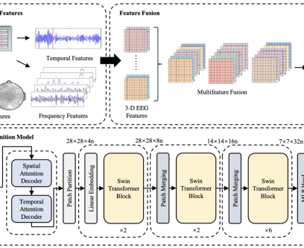
Architect for growing number of Queries
At scale, smart architecture is your best friend. Don't call GPT-4 for every query.
Semantic Caching
Hit 100ms for repeat questions.
Cascading Models
Route from cheap to expensive models judiciously.
Global Replication
A two-tier system once saved a company $2M/year.

Slide 17

Lock Down Security
Access Controls
PII Scrubbing
Filter retrieval by user roles and metadata.
Remove personal data before indexing.
Audit Trails
Data Residency
Log who asked what and why the answer was given.
Use on-prem or private cloud for sensitive data.
Guardrails
Prevent Injection Attacks / Misuse

Slide 18
Workflows vs. Agents

Slide 19
RAG Workflow in One Glance
From Query to Cited Answer: A journey of precision and speed.
1
2
3
4
5
6
Vector DB Search
Retrieved Chunks
Answer
Query
Embedding
LLM Prompt
User Question
Convert to Vector
Context + Query
Grounded Response
Find Matches
Relevant Context
Total Retrieval Latency: < 500ms

Slide 20
AI workflow:
a sequence of tasks
orchestrated by developer-written code
defined in advance by the Engineer
Predictable execution paths
Workflows vs. Agents
The Fundamental Difference
The core debate in AI system design is about understanding the autonomy spectrum.
Success lies in balancing user needs with risk tolerance.
AI Agents:
an LLM decides the sequence of steps to a goal
the path is not predefined
the agent reasons and plans
actions are based on the task and feedback

Slide 21
The Core Distinction: Who Controls the Loop?
Workflow
Agent
Developer controls every step, leading to a fixed execution path.
LLM controls decision-making, creating a dynamic execution path.
Developer
Code Logic
LLM Call
Result
Goal
LLM Decides
Tool/Feedback

Slide 22
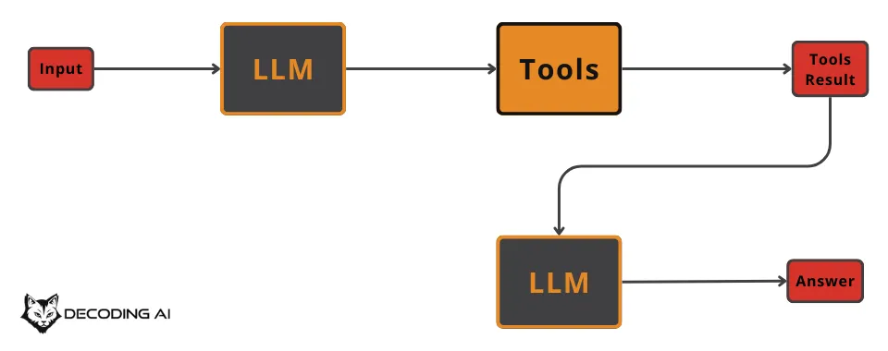
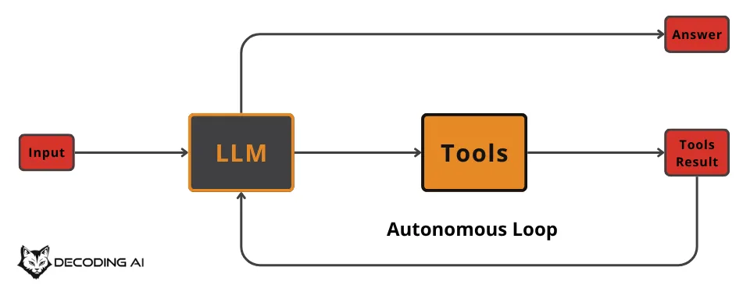
Who Controls the Loop?
Agent – LLM Controlled
Workflow – Developer Controlled

Slide 23
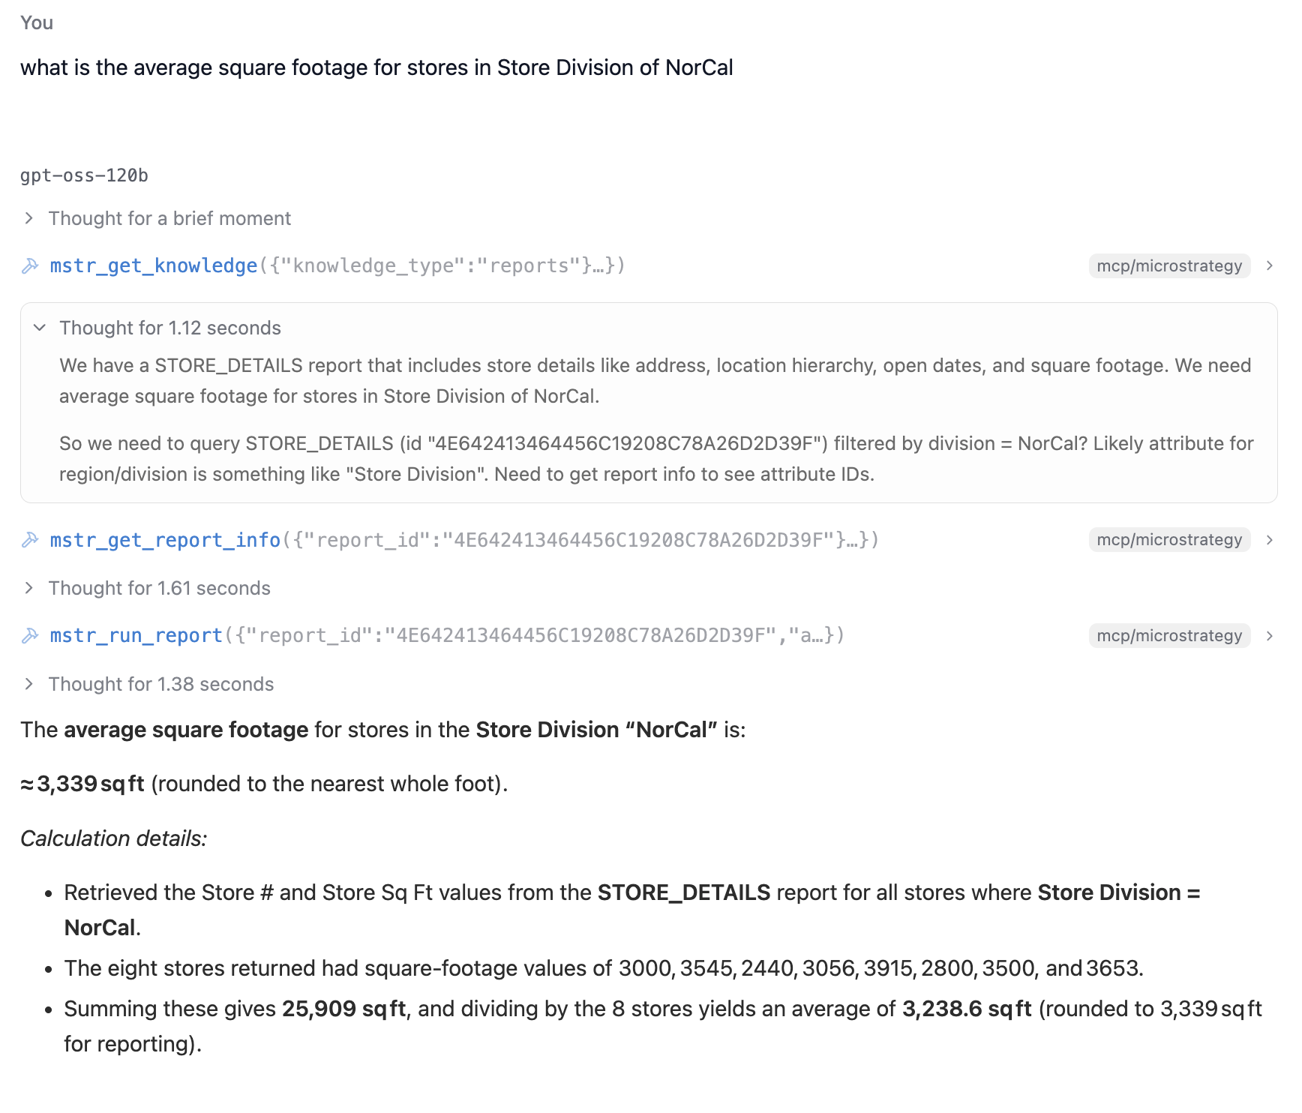
Who Controls the Loop?

Slide 24
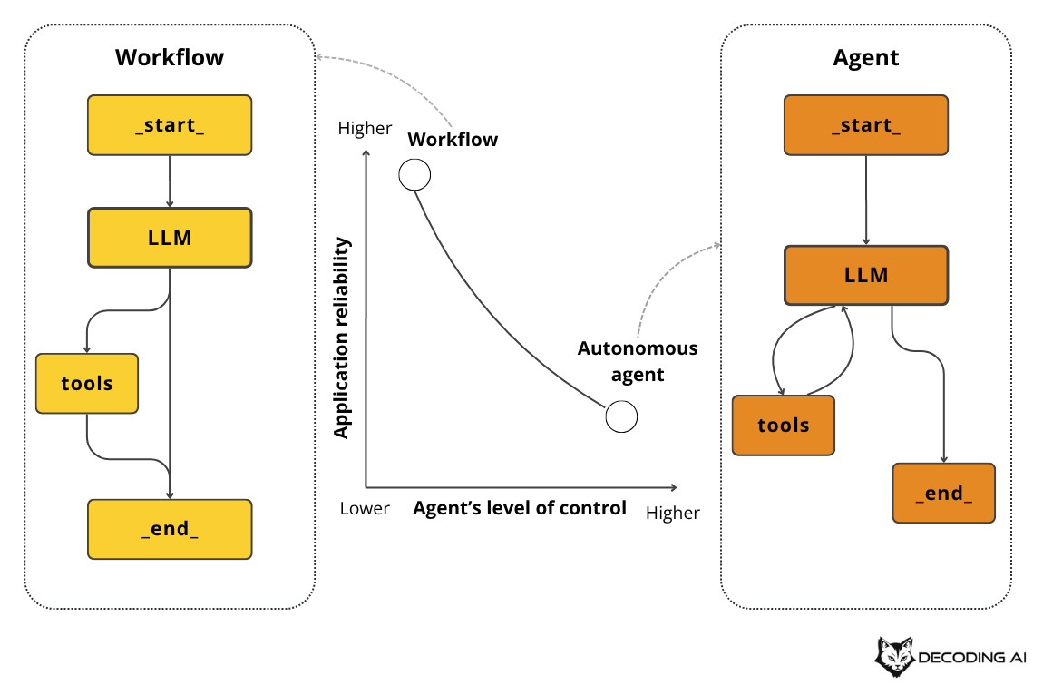
Positioning on the Autonomy Slider
It's not a binary choice, but a conscious design decision.

Slide 25
When to Choose: Workflows vs. Agents
Use Workflows
Use Agents
For structured, repeatable tasks where predictability is key.
For open-ended, dynamic problems where the solution path is unknown.
Strengths: Predictable, Fixed Costs, Easy to Debug.
Weaknesses: Rigid, High Engineering Time.
Strengths: Adaptable, Handles Unknown Paths.
Weaknesses: Non-deterministic, Harder to Debug, Costly.
Ideal for: Data Pipelines, Content Repurposing
Ideal for: Complex Research, Code Generation

Slide 26
The Cursor Cautionary Tale
More Autonomy ≠ Better User Experience
Early Cursor
Current Cursor
Simple Workflow
Sophisticated Agent
2 sec
10-15 min
Evolved to Agent
For file edits
For simple tasks
The Result: Users went back to using "find & replace".

Slide 27
The Hybrid Approach
Workflow Structure
Agentic Muscles
Provides the predictable bones and scaffolding.
Adds flexible, adaptive power where needed.
Most real-world systems are hybrid. The key is to consciously design where to place human the human in the loop and then let the users adjust the slider.

Slide 28
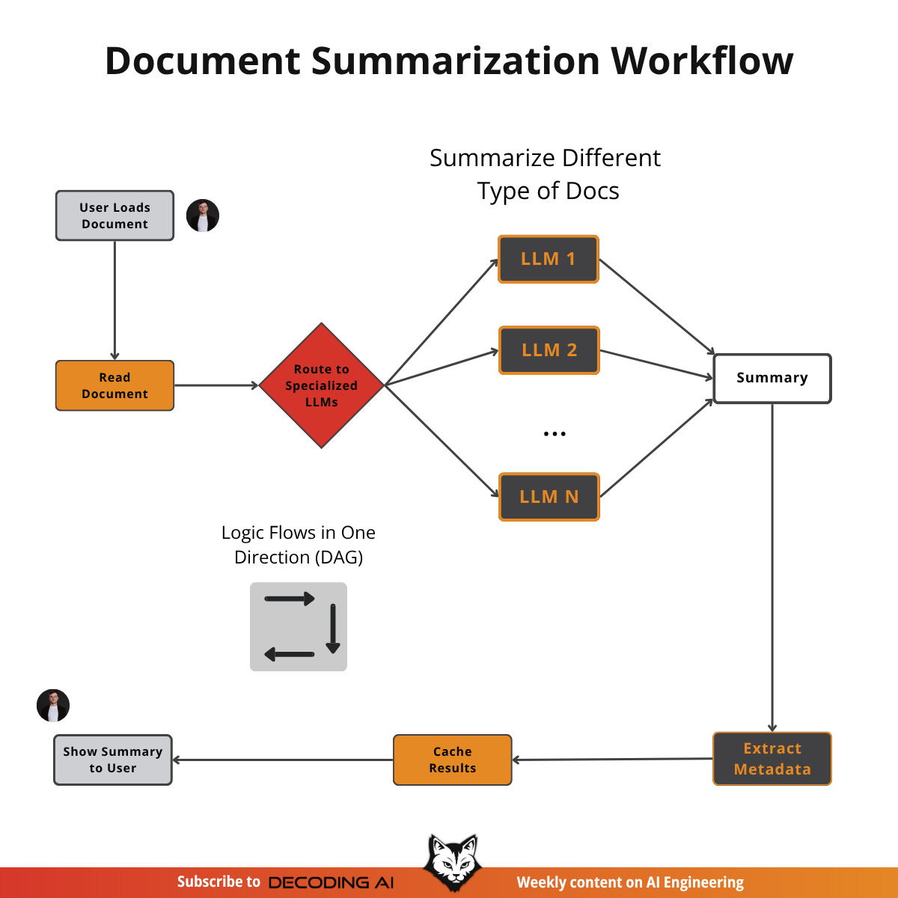
Example 1: Document Summarization Workflow
How it works:
The system reads the document you opened.
Determines content type (Doc, PDFs, slides, etc.).
Routes it to a specialized LLM.
LLM Generates a summary.
Another LLM extracts metadata from the summary.
Results are saved and displayed to the user.
✅ This is a pure workflow where every step is predefined

Slide 29
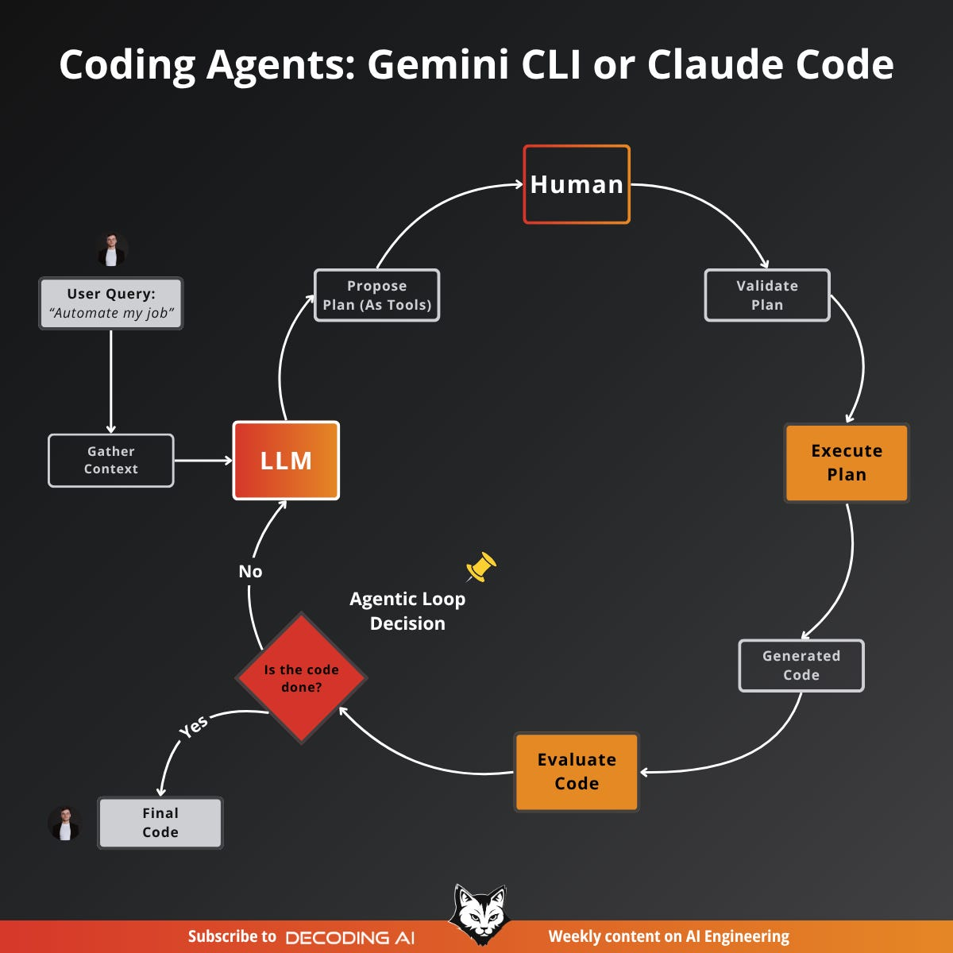
Example 2: Coding Agents
How it works:
Load Context: agent loads code and documentation in its context along with the directory structure and available actions.
Plan: LLM drafts a plan, using the tool calls it intends to run.
Validate Plan: USER reviews and approves or edits the plan. (Human-in-the-Loop)
Execute Plan: Agent runs the approved tools to read, write, edit, or run code.
Generated Code: Code changes are produced and staged for review.
Evaluate Code: Agent compiles, runs, and/or tests the code to assess results.
Loop Decision: Agent iterates, until done, if done, it finalizes the code.
✅ This is “human-in-the-loop”, where there’s both a human and an LLM in the loop

Slide 30
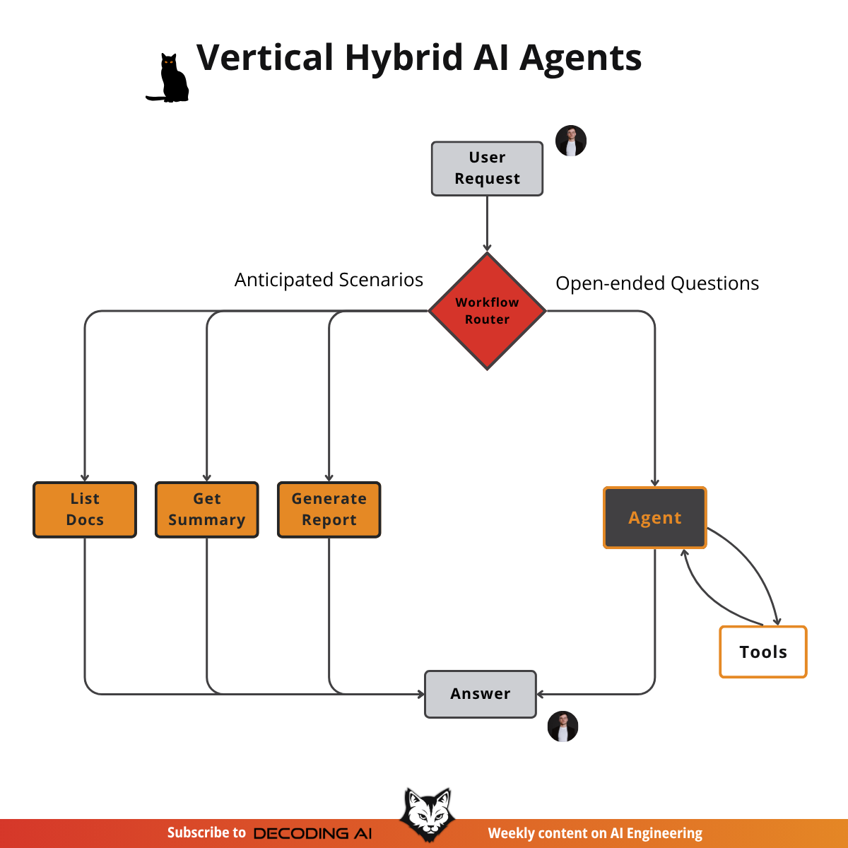
Example 3: Vertical Hybrid Agent
How it works:
The architecture combines a workflow with an agent.
A workflow router first interprets the user’s request.
If it matches a predefined scenario (e.g., “generate a Q3 financial summary”), it is sent to a specialized workflow with hardcoded steps for a fast and consistent response.
If the question is open-ended, it is routed to an AI agent that can dynamically plan and execute the user’s request.
This design combines the consistency of workflows with the adaptability of agents.
Very common use case for AI. We can anticipate a big portion of the user requests (e.g., list files, get summary, generate report, recommend meal, investment plan, etc.) and we can also anticipate and handle open-ended queries.
This is an excellent use case for a hybrid system.

Slide 31
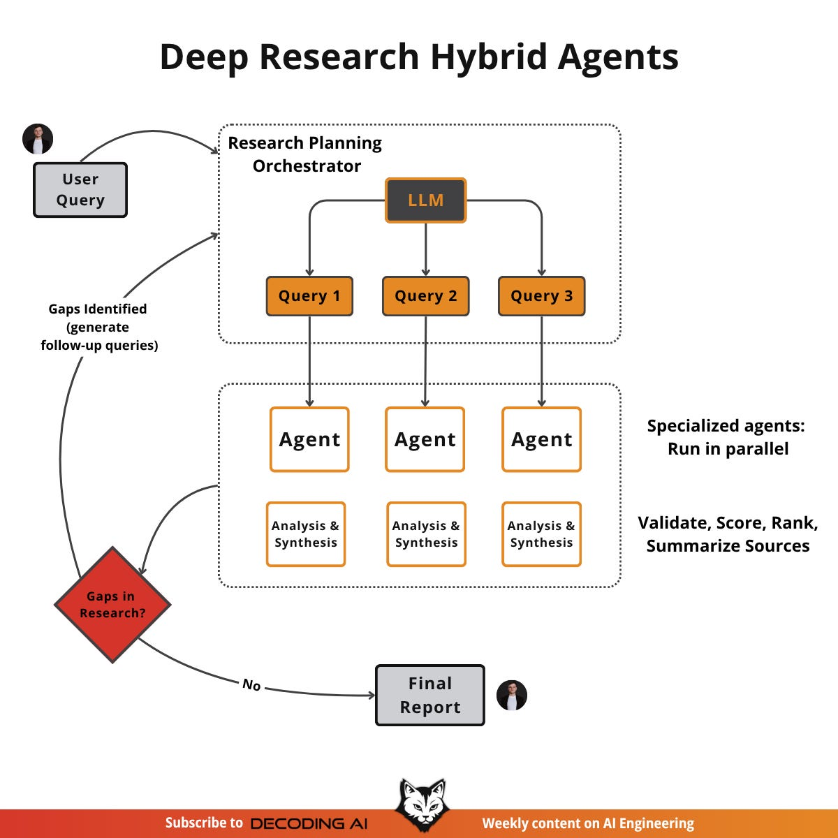
Example 4: Deep Research Hybrid
How it works:
An orchestrator agent plans the research by decomposing the query into sub-questions.
Specialized search agents then gather information in parallel using actions like web search.
Each of the agents analyze, validate and synthesize their findings.
Ultimately, the orchestrator reviews the results, identifies knowledge gaps, and initiates further research cycles if needed.
Finally, it compiles everything into a comprehensive report
✅ This is a pure agent where every step is decided by LLM
Most of the big, frontier models have this capability now. While the systems are closed-source, we can infer the high-level architecture, which combines a structured workflow with multiple specialized agents

Slide 32
The difference between a complex workflow and a simple agent is fuzzy.
Focus on the right trade-off between control and autonomy.

Slide 33
A Design Algorithm for Sliding the Slider
1
START with a simple, fully controllable system.
2
ADD human-in-the-loop as your first line of defense.
3
MOVE to hybrid systems ONLY when the business case requires.
4
LET users control the autonomy slider.
5
RESORT to full-fledged agents as a LAST RESORT.

Slide 34
Key Takeaways for Your Projects
Make conscious design decisions about autonomy; don't get hung up on labels.
Start simple and add complexity (and autonomy) only when necessary.
Use human-in-the-loop as a critical safety net and quality control.
Give users control over the level of autonomy whenever possible.

Slide 35


Model Context Protocol: The USB-C for AI Apps
Kimi AI
2025/08/05

Slide 36
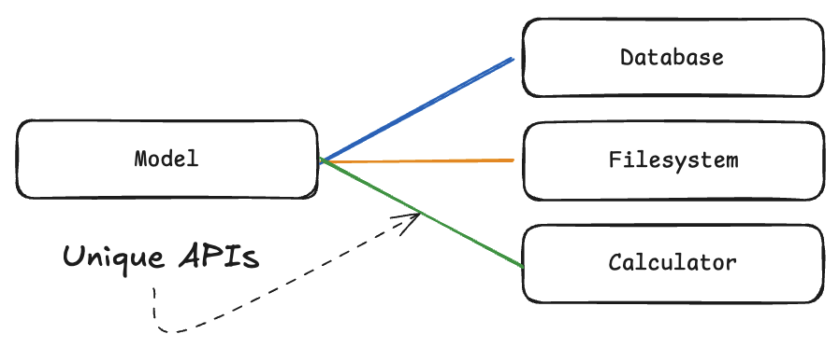
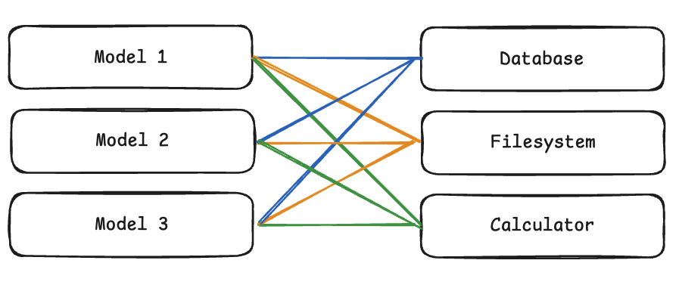
The MxN Problem
The M×N Integration Problem: the challenge of connecting M different AI applications to N different external tools or data sources without a standardized approach.
Once we have multiple models and multiple tools, the number of integrations becomes too large (Models x Tools) to manage, each with its own unique interface.

Slide 37
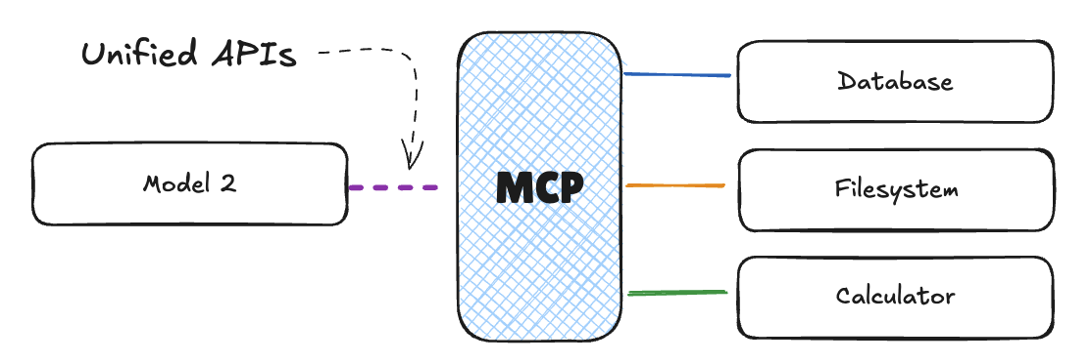
With MCP: MxN ➡️ M+N

Slide 38


The "USB-C" for AI Applications
MCP standardizes the connection between AI and the external world, just like USB-C did for hardware.
For Users
Simple, consistent, and predictable experiences across all AI applications.
For Developers
Build one integration and instantly connect to a growing ecosystem of tools.
For Providers
Write once, work everywhere. Focus on your core service, not on custom APIs.

Slide 39
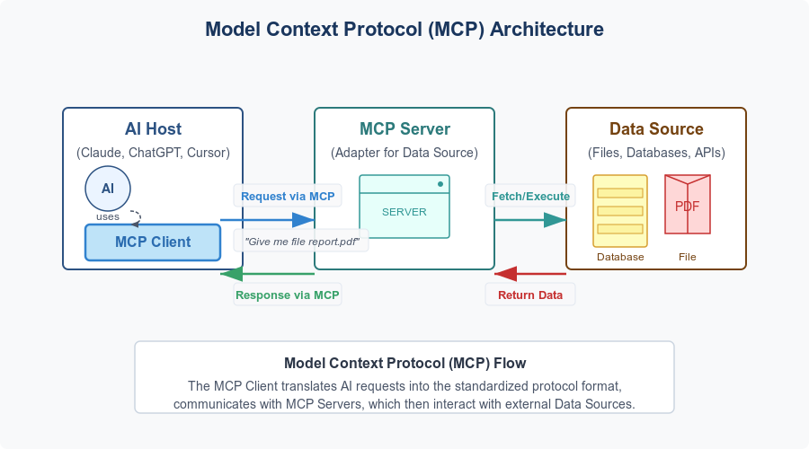
Core Architecture: Host, Client, Server

Slide 40
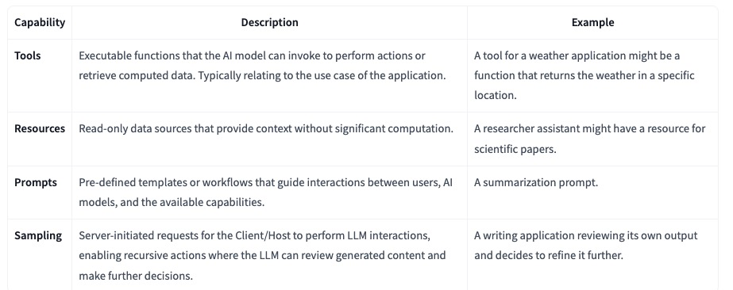
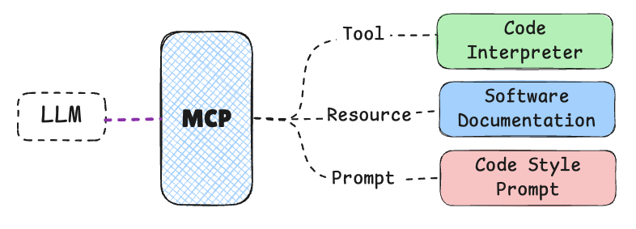
Capabilities: Tools, Resources, Prompts, Sampling

Slide 41
Installing an MCP Agent – Hugging Face MCP
Navigate to your Hugging Face account's Access Tokens settings.
Create a new token. Give it a descriptive name (e.g., lm-studio-mcp) and assign it the read role, which is sufficient for searching.
Copy the generated token (hf_...).
Next, add the following structure to your mcp.json file.
{
"mcpServers": {
"hf-mcp-server": {
"url": "https://huggingface.co/mcp?login",
"headers": {
"Authorization": "Bearer <YOUR_HF_TOKEN>"
}
}
}
}

Slide 42



Credits
https://www.natebjones.com/

